Slide 1
Human Impact
Understanding how our actions affect the environment

Slide 2

Introduction
This presentation explores the significant ways in which human activities, especially pollution and climate change, have detrimental effects on the environment.

Slide 3
01
Pollution

Slide 4
Air pollution from industrial activities
Industrial activities release large amounts of pollutants into the air, leading to respiratory problems, environmental degradation, and climate change. These emissions include carbon monoxide, sulfur dioxide, and particulate matter, adversely affecting public health and contributing to global warming.

Slide 5
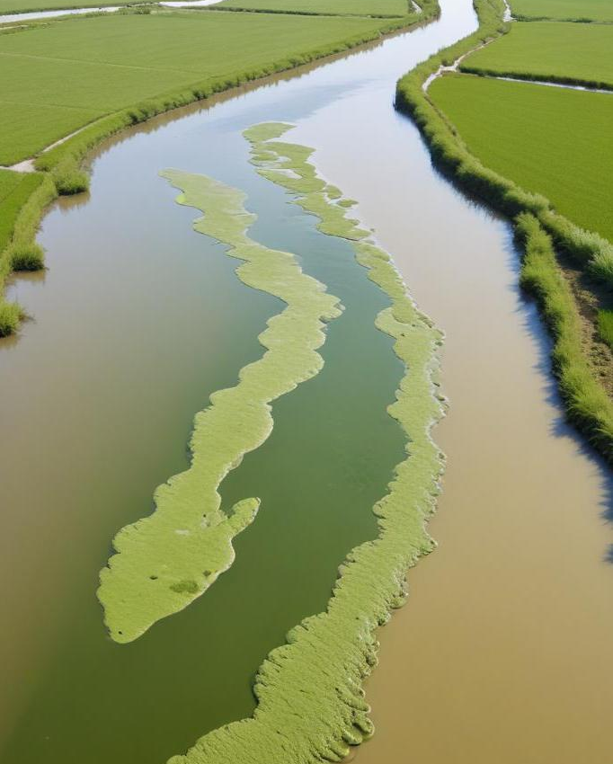
Water pollution due to agricultural runoff
Agricultural runoff is a major source of water pollution, carrying fertilizers, pesticides, and animal waste into rivers and lakes. This excess nutrient load can lead to algal blooms, dead zones, and harm aquatic ecosystems. Contamination of drinking water sources also poses severe health risks to humans.

Slide 6
Soil contamination from waste disposal
Soil contamination occurs when hazardous waste materials are improperly disposed of, introducing toxic substances into the soil. Sources include landfills, industrial waste, and chemical spills. This contamination can harm crops, reduce soil fertility, and pose health risks to humans and wildlife through the food chain.

Slide 7
02
Climate Change

Slide 8
Greenhouse gas emissions from transportation
Transportation is a significant contributor to greenhouse gas emissions, primarily through the combustion of fossil fuels in vehicles. Cars, trucks, and airplanes release carbon dioxide and methane into the atmosphere, exacerbating global warming and contributing to climate-related impacts such as severe weather and loss of biodiversity.

Slide 9
Deforestation and its effects on carbon levels
Deforestation leads to increased carbon levels in the atmosphere as trees and plants that absorb carbon dioxide are removed. This loss of forest cover not only contributes to climate change but also destroys habitats for countless species. Deforestation accelerates soil erosion, disrupts water cycles, and affects global weather patterns.

Slide 10
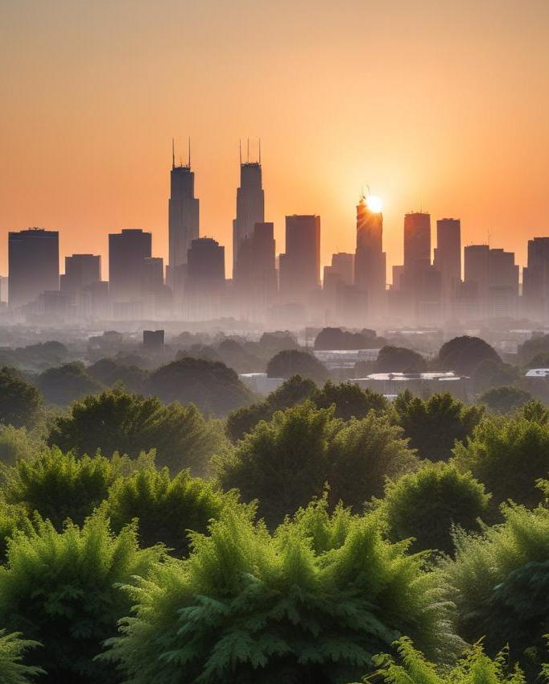
Impact of urbanization on local climates
Urbanization significantly alters local climates by creating heat islands, where cities become warmer than surrounding rural areas. The increase in concrete surfaces and decreased greenery leads to higher temperatures and altered precipitation patterns. These changes can exacerbate energy demands and impact public health.

Slide 11

Conclusions
Human activities such as pollution and climate change have profound impacts on the environment. To mitigate these effects, it is crucial to adopt sustainable practices, enhance public awareness, and promote policies that protect our planet for future generations.

Slide 12
Thank you!
Do you have any questions?
Please keep this slide for attribution

